Slide 1

Denver Real Estate Estimator
How to spend or invest your money is a difficult decision
Historic data can help to inform you

Slide 2
1. Data
Data was sourced from the city of Denver's Open Data Catalog (https://www.denvergov.org/opendata/dataset/city-and-county-of-denver-real-property-sales-and-transfers)
There were two files that had to be loaded:
a Sales file that recorded individual sales since 2008
a Characteristics file that gives details for each property

Slide 3
2. Data Cleaning
The data came in very clean with few missing fields.
Some Sales records that did not find matches in the Characteristics file were dropped.

Slide 4
3. Exploratory Data Analysis
Two major problems were revealed during EDA:
fields that had been duplicated when the Sales and Characteristics files were combined
the linear relationship between Total Values and Assessed Values
Reviewing the input data revealed whole categories which would not be of interest for modeling such as owner and address information.

Slide 5
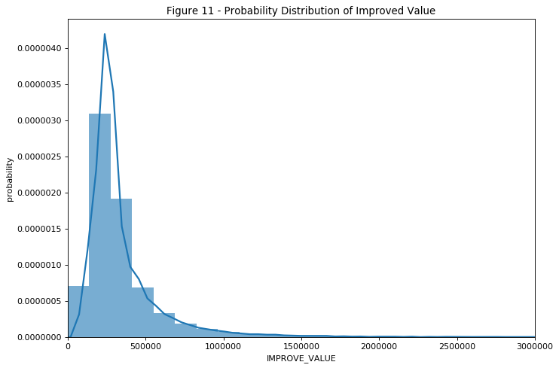
4. Modeling
Target: IMPROVE_VALUE – a continuous numeric field
Not normally distributed
Supervised Learning

Slide 6
4. Modeling (continued)
Initial results
 | Linear Regression | Random Forest | K nearest neighbors | SVR
Explained variance | 0.67 | 0.92 | 0.84 | 0.40
Mean absolute error | 98,359.41 | 34,067.52 | 51,457.22 | 105,983.12
R2 score | 0.67 | 0.92 | 0.84 | 0.37

Slide 7
4. Modeling (continued)
Random Forest Model was selected
Runs well on large databases
Works well with a large group of input features
Handles data that is not normally distributed
Can handle missing data (not an issue in this case)

Slide 8
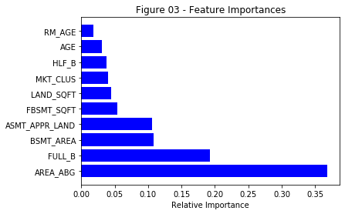
4. Modeling (continued)

Slide 9
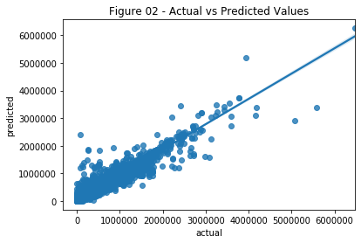
5. Predictions

Slide 10
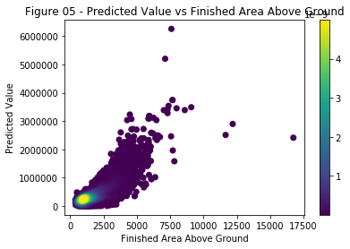
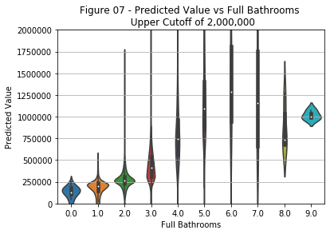
5. Predictions (continued)

Slide 11
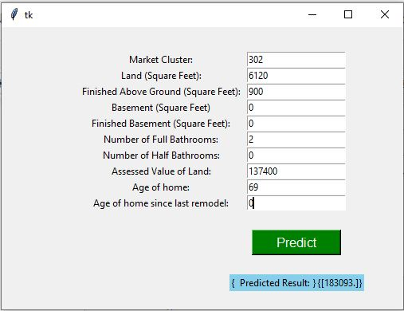
6. Interactive Prediction
Provided in Jupyter notebook:

Slide 12
7. Future Improvements
The MKT_CLUS was not identified in the metadata from Denver and yet was one of the features that was identified as important. Some additional understanding of what it is would be helpful.
The information included in these models was from completed sales. It does not include information about property that was put up for sale but never sold or information about how long the sale took.

Slide 13
Code
https://github.com/NancyKecso/Springboard/tree/master/Capstone 2 Denver Real Estate

